Slide 1


A Look at Customer Acquisition and Value – Justifying Marketing Spend
BY Team Orange
Notes:
Introduce group and team names
Set scene – annual cost review, flagged sharp marketing spend increase, also plan to invest in acquisition

Slide 2
Executive Summary
New Customers Have High CLV But Don’t Stay
Recommendation – Bring back Prism Plus, but altered
Impact – Increase in NSM by incentivising repeat purchases. Also, increase retention relating to the first point
Acquisition Should Not be the Only Focus
Recommendation – Split marketing effort between acquisition and retention
Impact – 5% increase in retention could improve profit by up to 25% according to industry research
Marketing should be directed at Google channels
Recommendation – Focus marketing budget on Google with emphasis on CPC and organic.
Impact – Continued traffic of high CLV customers, leading to continued revenue performance

Slide 3

Newer customers have higher CLV but don’t stay
The average CLV in 2022 is 2x of 2020 and 2021.
Increase in marketing spend is justified.
Bring back the loyalty scheme
Year | CLV / £ | Average Order Value / £
2020 | 42.18 | 23.96
2021 | 42.70 | 24.65
2022 | 85.58 | 37.08
Notes:
CLV is the total amount you're likely to receive from an individual customer during their relationship with your company.
Marketing spend is somewhat justified because we can see that average CLV has increased in 2022. The average order value has also increased.
For all 3 years it follows the same trend because they have fewer months to be a customer.
Customers aren't staying. 66% of customers are only making one purchase.
Bring back the loyalty scheme that actually helps customer repeat purchases.

Slide 4
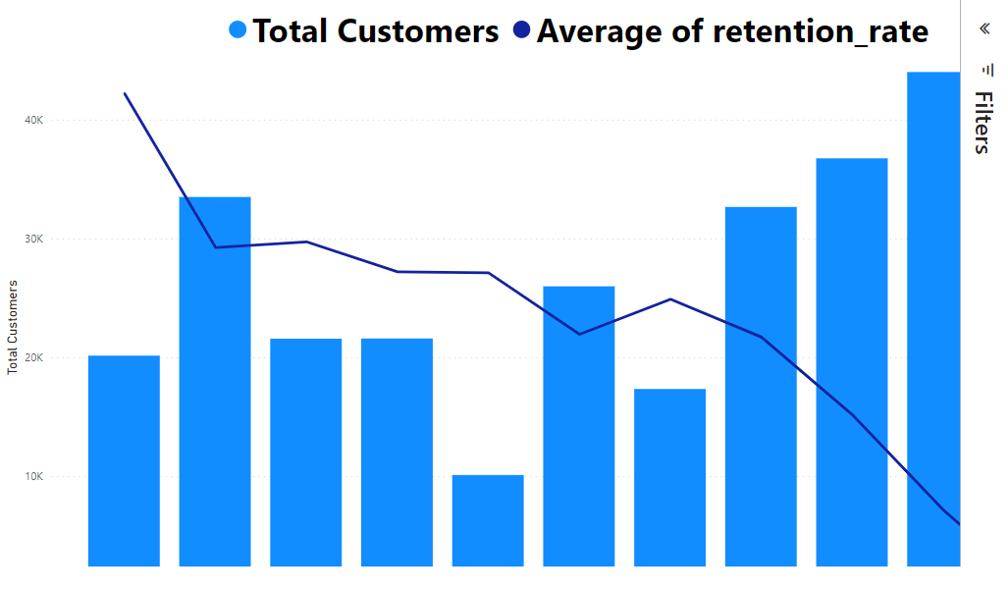
Acquisition Should Not be the Only Focus
We have seen rapid growth in the customer base in 2022
Growth is accompanied by lower retention rates
Notes:
josh

Slide 5
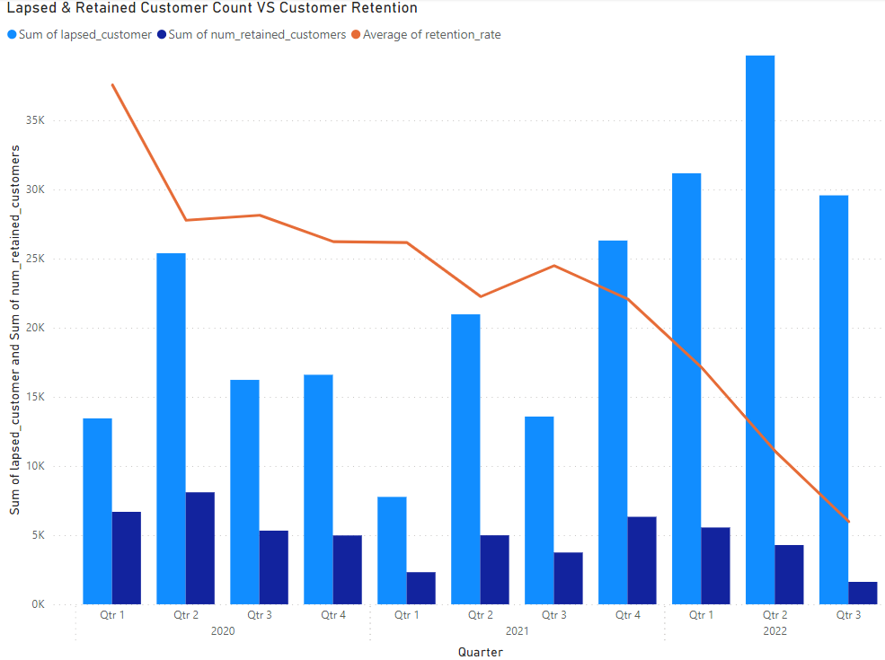
Lapsed Customer Growth
Lapsed customer count increases with customer base growth
Proportionally, fewer customers stay after a quarter
Notes:
Josh

Slide 6
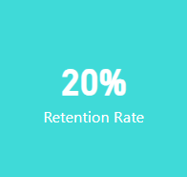
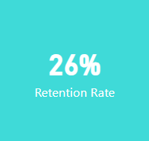
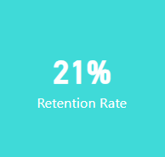
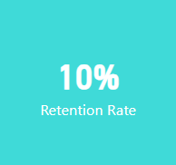
Retention Woes
An industry Standard for “good” customer Retention in E-commerce is 0.30
Anything above is extremely Positive
Average
2020
2021
2022
Notes:
Retention is cheaper than acquisition

Slide 7
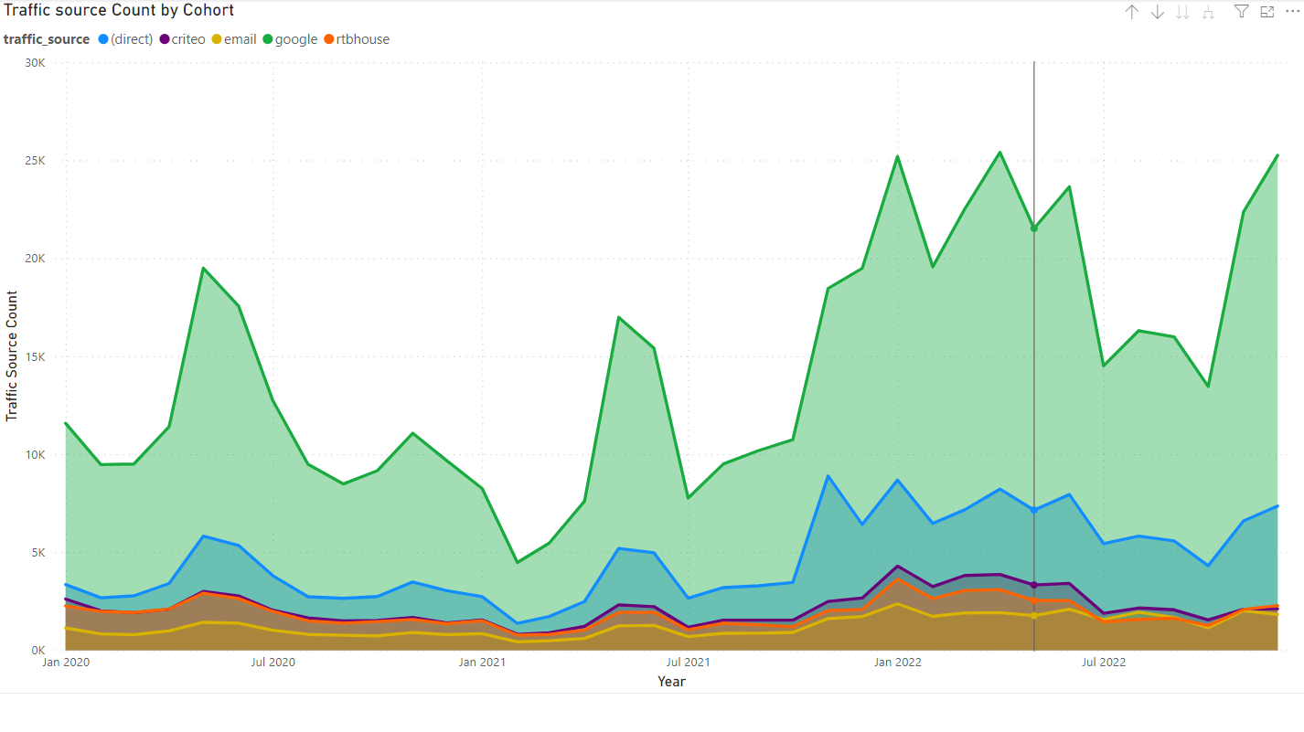
Marketing should be directed at Google channels
Overall traffic count is by far the highest for Google
Marketing should continue to invest on Google marketing

Slide 8
Conclusion
New customers have higher CLV as of 2022 but aren’t continuing with us past a quarter
We should augment our service, bringing back a loyalty scheme to incentives repeat purchasing
This will increase our NSM and help retain newer, more valuable customers
Acquisition isn’t the most important business task and retention shouldn’t be ignored
We should split resources between these 2 areas
Increasing retention rates by just 5% can lead to a 25% increase in yearly profit
Marketing Spend going forward should be favoured for Google
Don’t change the funding allegation
This will lead to a continued influx of higher-value customers and marketing performance.

Slide 9

Data Improvements
Clear marketing cost data
Allows accurate calculation of CAC
Allows quantitative analysis of ROI
Development of Attribution framework
Clearer division between marketing credit and how this relates to CAC

Slide 10

Definitions & Assumptions
Customer Lifetime Value – the total amount you're likely to receive from an individual customer during their relationship with your company
Lapsed customers – customers whose last purchase was within 3 months from their first purchase month
New customers – number of customers with the first_purchase_date in each month
Retention rate – the proportion of customers who continue to use our service for over a quarter

Slide 11
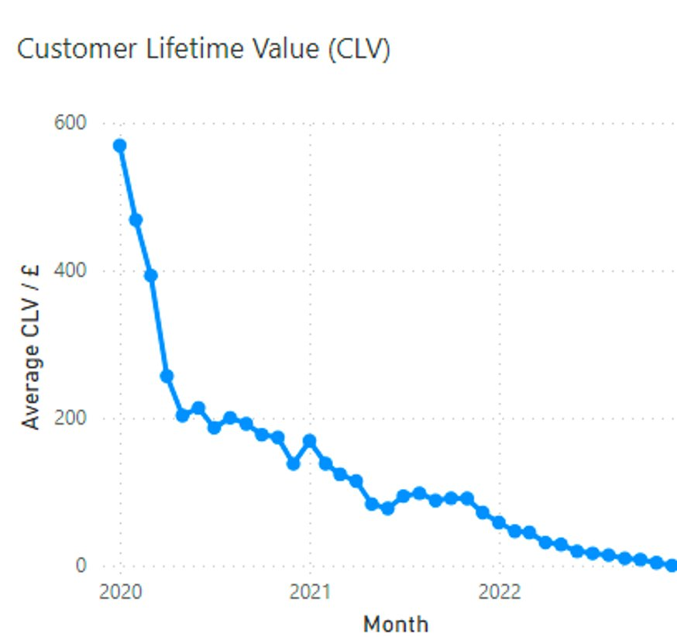
Appendix 1: Date Biased CLV

Slide 12

Appendix 2

Slide 13
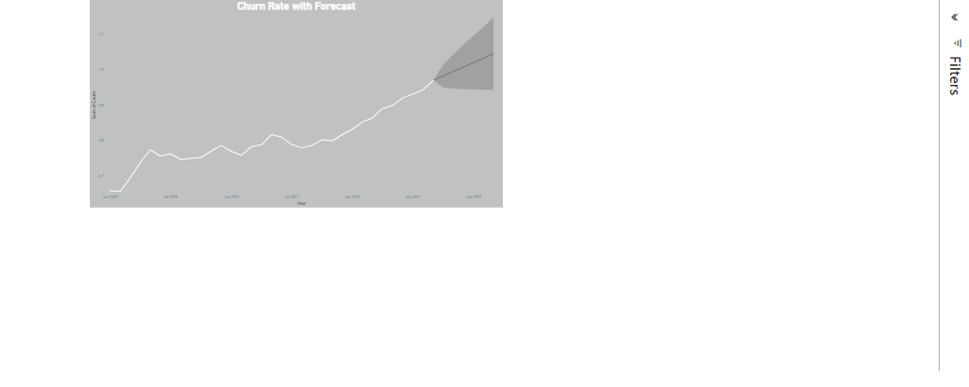
Appendix 3: Churn Rate Forecast

